Slide 1
Chapter 00
Introducing Foundations

Slide 2

Contents
Primality testing. [9-11, 15-18]
Carmichael numbers. [19-20, 24-26]
Finding Large Prime Numbers [30-34]

Slide 3
Elementary Number-Theoretic Notions
An application of number-theoretic algorithms is in cryptography
the discipline concerned with encrypting a message sent from one party to another, such that someone who intercepts the message will not be able to decode it.
Let the set Z = { …., -2, -1, 0, 1, 2, 3, ….} of integers.
Let the set N = {0, 1, 2, 3, ….} of natural numbers (nonnegative integers.
The notation d | a (read “d divides a”) means
that a = k*d for some integer k, (i.e., a is k multiple of d).

Slide 4

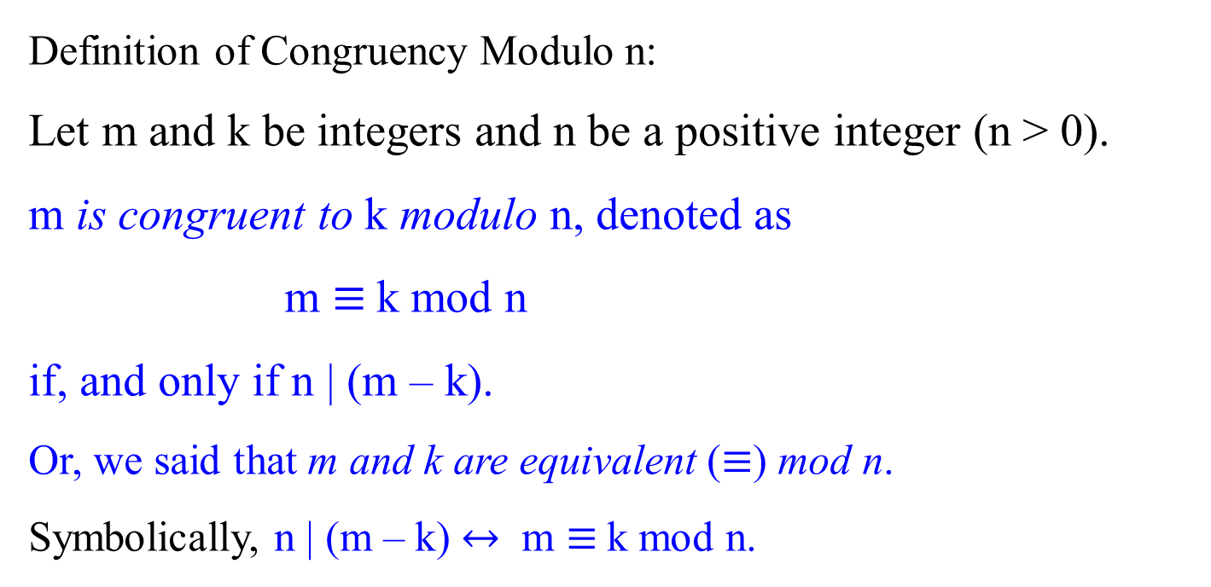
Congruence Modulo n : m and k are congruent modulo n
Definition of Congruency Modulo n:
Let m and k be integers and n be a positive integer (n > 0).
m is congruent to k modulo n, denoted as
m $≡$k mod n
if, and only if n | (m – k).
Or, we said that m and k are equivalent ($≡$) mod n.
Symbolically, n | (m – k) $↔$ m $≡$k mod n.

Slide 5
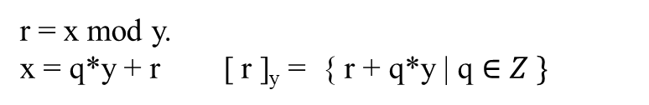

r = x mod y.
x = q*y + r [ r ]_{y} = { r + q*y | q $∈Z \}$
Let Z be the set of integers {…, -2, -1, 0, 1, 2, … }.
All integers can be partitioned into n equivalence classes, according to their remainders modulo n.
Define the equivalence class modulo n containing an integer a to be
[a]_{n} = {a + k n | k ɛ Z},
For example, [3]₇ = { …, - 25, -18, -11, -4, 3, 10, 17, 24, 31, 38, …}.
i.e., b $∈$ [a]_{n} iff b ≡ a (mod n).
iff n | (b – a). i.e., b must be equal to a + kn.

Slide 6

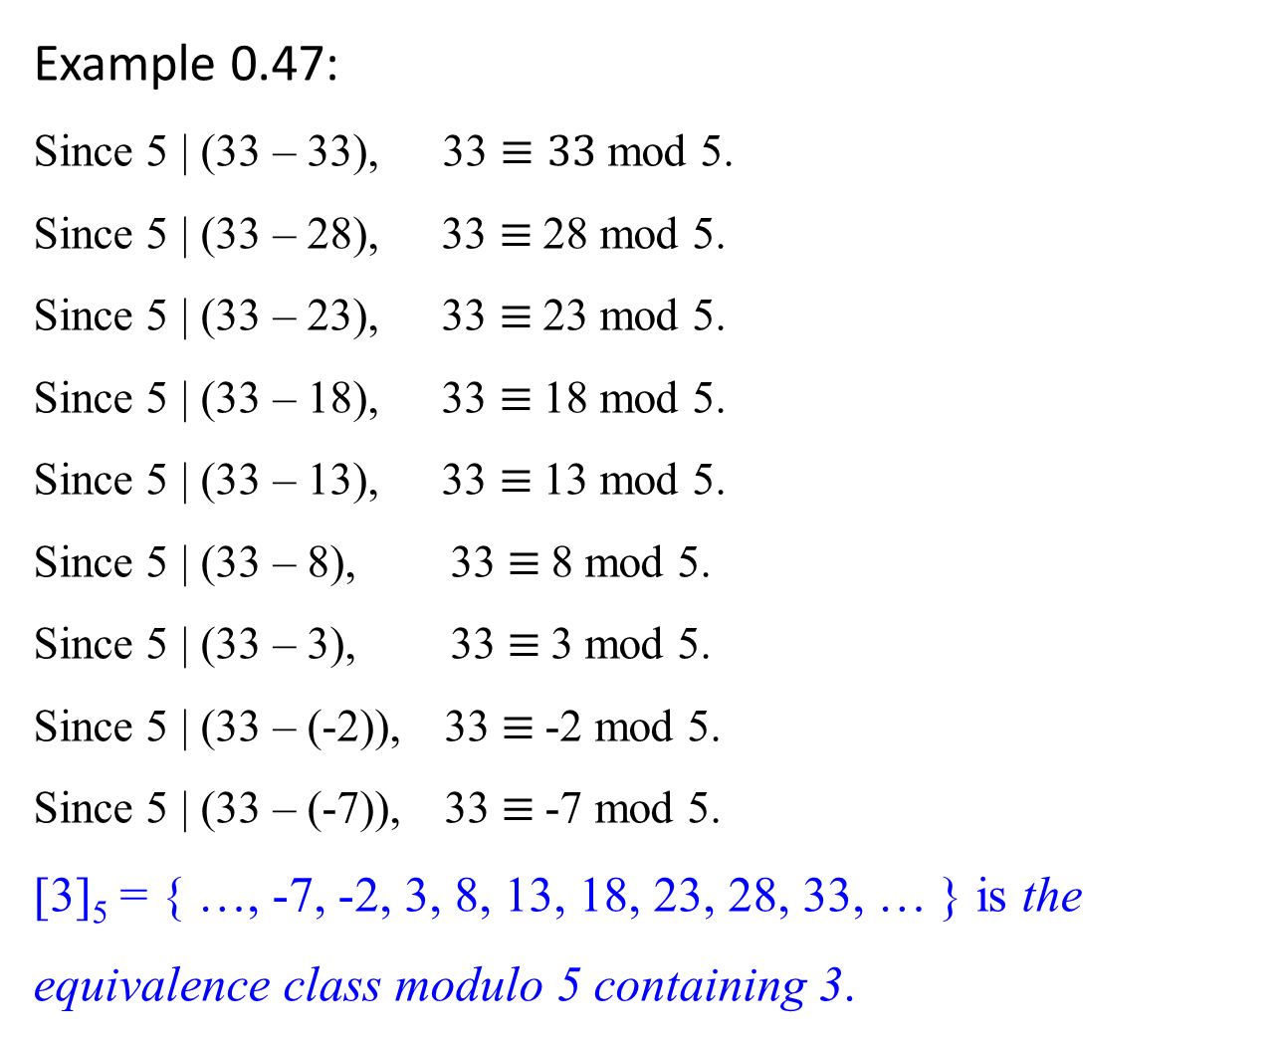
Example 0.47:
Since 5 | (33 – 33), 33 $≡33$ mod 5.
Since 5 | (33 – 28), 33 $≡$28 mod 5.
Since 5 | (33 – 23), 33 $≡$23 mod 5.
Since 5 | (33 – 18), 33 $≡$18 mod 5.
Since 5 | (33 – 13), 33 $≡$13 mod 5.
Since 5 | (33 – 8), 33 $≡$8 mod 5.
Since 5 | (33 – 3), 33 $≡$3 mod 5.
Since 5 | (33 – (-2)), 33 $≡$-2 mod 5.
Since 5 | (33 – (-7)), 33 $≡$-7 mod 5.
[3]₅ = { …, -7, -2, 3, 8, 13, 18, 23, 28, 33, … } is the equivalence class modulo 5 containing 3.
5 | (33 – (-7)) or 5 | (-7-33)

Slide 7

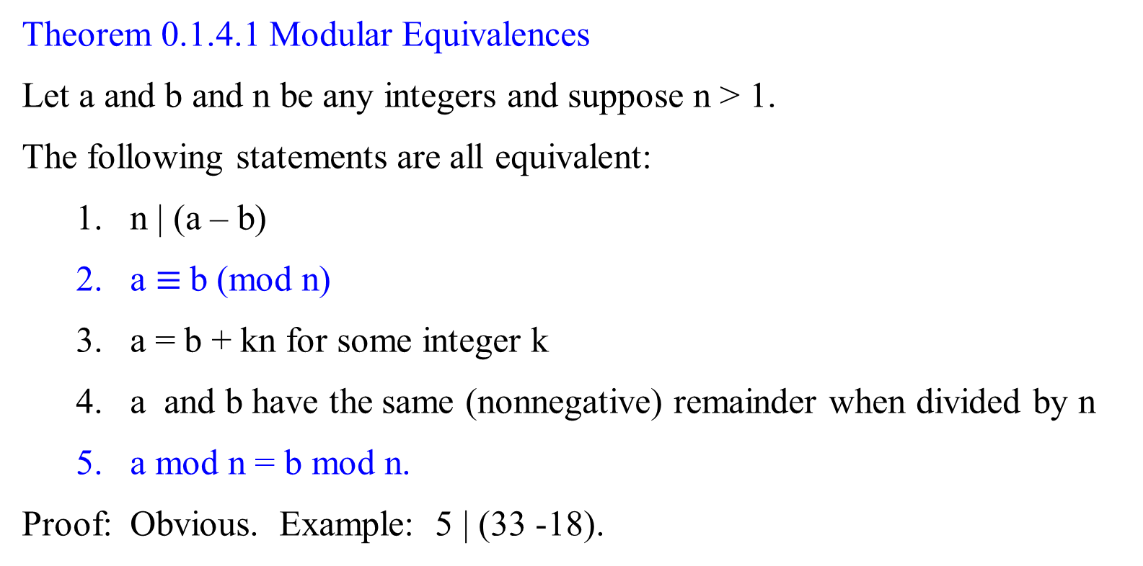
Theorem 0.1.4.1 Modular Equivalences
Let a and b and n be any integers and suppose n > 1.
The following statements are all equivalent:
n | (a – b)
a $≡$b (mod n)
a = b + kn for some integer k
a and b have the same (nonnegative) remainder when divided by n
a mod n = b mod n.
Proof: Obvious. Example: 5 | (33 -18).

Slide 8
Primality testing

Slide 9

Primality testing
Do we have any way to know a number is prime without actually trying to factor the number?
Fermat's little theorem states that if p is a prime number, then for any integer a, the number a^{p} − a is an integer multiple of p.
In the notation of modular arithmetic, a^{p} ≡ a (mod p).
That is, p | (a^{p} – a)
For example,
if a = 2 and p = 11, 2¹¹ = 2048, and
2048 − 2 = 186 × 11, an integer 186 multiple of 11.
That is, 11 | 2¹¹ – 2, where 11 is a prime. i.e., 2¹¹ ≡ 2(mod p).
If a = 2, and p = 12, 2¹² = 4096, then 12 ┼ 2¹² -2
i.e., (a^{p} – a) mod p = 0.

Slide 10
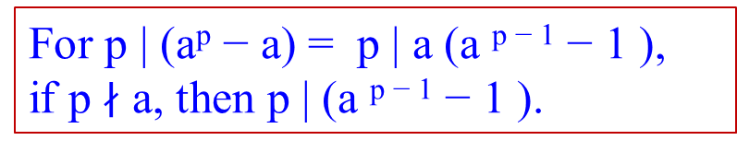
Primality testing
Do we have any way to know a number is prime without actually trying to factor the number?
Fermat's little theorem states that:
if p is a prime number,
then for any integer a, the number a^{p} − a is an integer
multiple of p.
In the notation of modular arithmetic, a^{p} ≡ a (mod p).
If a is not divisible by p, Fermat's little theorem is equivalent to the statement that a^{p − 1} − 1 is an integer multiple of p, or in symbols.
a^{p-1} ≡ 1 (mod p).
i.e., (a^{p} – a) mod p = 0.
a(a^{p-1} – 1) mod p = 0
(a^{p-1} – 1) mod p = 0
a^{p-1} ≡ 1 (mod p)
For p | (a^{p} − a) = p | a (a ^{p − 1} − 1 ),
if p $∤$ a, then p | (a ^{p − 1} − 1 ).
gcd(a^{p-1}, p) = 1

Slide 11

Let formally state:
Fermat’s little theorem (1640):
If p is prime, then for every integer 1 ≤ a < p,
a^{p-1} ≡ 1 (mod p).
Since m $≡$k mod n if, and only if n | (m – k),
a^{p-1} ≡ 1 (mod p) if, and only if p | (a^{p-1} - 1).
a^{p-1} is congruent to 1 modulo n
1 ≤ a < p condition is to define the equivalence classes modulo p. such as [1]₇, [2]₇, [3]₇, [4]₇, [5]₇, and [6]₇.
If a = 0, a^{p-1} is undefined.
If a $≥$ p then it will repeat the equivalence classes.

Slide 12

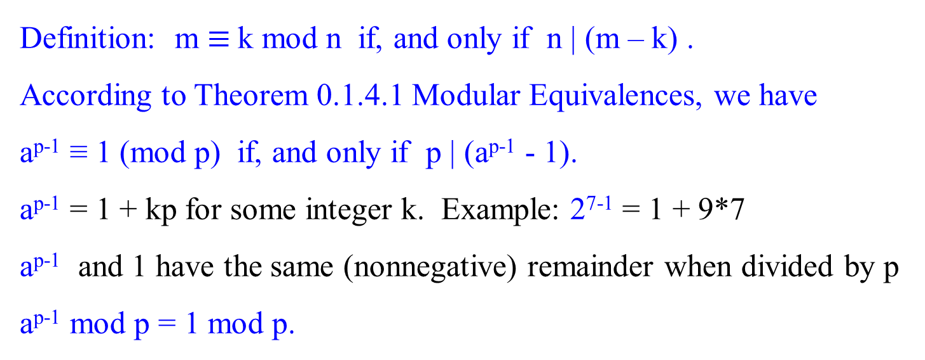
Definition: m $≡$k mod n if, and only if n | (m – k) .
According to Theorem 0.1.4.1 Modular Equivalences, we have
a^{p-1} ≡ 1 (mod p) if, and only if p | (a^{p-1} - 1).
a^{p-1} = 1 + kp for some integer k. Example: 2⁷⁻¹ = 1 + 9*7
a^{p-1} and 1 have the same (nonnegative) remainder when divided by p
a^{p-1} mod p = 1 mod p.

Slide 13
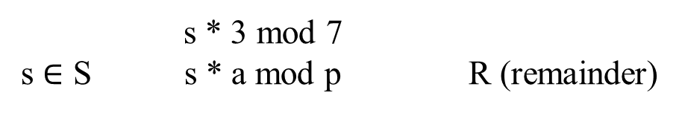
s * 3 mod 7
s $∈$ S s * a mod p R (remainder)
6! mod 7 = 720 mod 7 = 6.
Let p be 7and 1 ≤ a < p.
a^{p-1} ≡ 1 (mod p),
3⁶ * 6! (mod 7)
= 729 * 720 (mod 7)
= 524880(mod 7) = 6.
Or
729 * 720 (mod 7)
= 729 (mod 7) * 720 (mod 7)(mod 7)
= 1 * 6 (mod 7) = 6.
Therefore, 6! and 3⁶ * 6! are of the same class, denoted as
6! ≡ 3⁶ * 6! (mod 7).
1
1
2
2
3
3
4
4
5
5
720 =120* 2*3 %7=6
6
6
Let a = 3, p = 7, 3%7= 3:
729/7 =1
If s is 1, 2, 3, 4, 5, 6, then 1*3% 7 = 3; 2*3% 7 = 6; 3*3% 7 = 2;
4*3% 7 = 5; 5*3% 7 = 1; 6*3% 7 = 4;
If s is 8, 9, 10, 11, 12, 13, i.e., 1+1*7=8; 2+1*7= 9;…; 6+1*7= 13;
then 8*3%7= 3; 9*3%7=3;…; 13*3%7=4
… general term of s: s = s+i*p, 0 < i < p

Slide 14
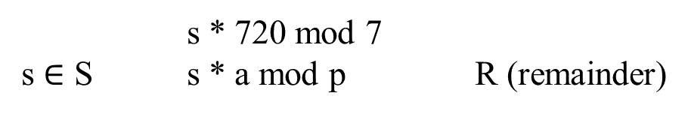
s * 720 mod 7
s $∈$ S s * a mod p R (remainder)
6! mod 7 = 720 mod 7 = 6.
Let p be 7and 1 ≤ a < p.
a^{p-1} ≡ 1 (mod p),
3⁶ * 6! (mod 7) [note that 3⁶ ≡ 1 mod 7]
= 729 * 720 (mod 7) [1 * 720 mod 7 = 6]
= 524880(mod 7) = 6. [otherwise, do *]
Or
729 * 720 (mod 7)
= 729 (mod 7) * 720 (mod 7)(mod 7)
= 1 * 6 (mod 7) = 6.
Therefore, 6! and 3⁶ * 6! are of the same class, denoted as
6! ≡ 3⁶ * 6! (mod 7).
1
1
2
2
3
3
4
4
5
5
6
6
a = 720, p = 7, 720%7= 6:
s is 1, 2, 3, 4, 5, 6: 1*720%7 = 6; 2*720%7 = 5; 3*720%7 = 4;
4*720%7 = 3; 5*720%7 = 2; 6*720%7 = 1;
8, 9, 10, 11, 12, 13: 1+1*7=8; 2+1*7= 9; …; 6+1*7= 13;
15, 16, 17, 18, 19, 20: 1+2*7=15; 2+2*7=16;…, 6+2*7=20
…
729, … : 1+104*7=729;
Then 729*720%7 ≡ 1*6%7
general term of s: s = s+i*p, 0 < s < p; 0 < i.

Slide 15

Recall:
Fermat’s little theorem (1640):
If p is prime, then for every integer 1 ≤ a < p,
a^{p-1} ≡ 1 (mod p).
i.e., gcd(a^{p-1}, p) = 1; p|(a^{p-1} -1); a^{p-1} mod p = 1 mod p.
This theorem suggests a “factorless” test for determining whether a number N is prime:
Determine whether 13 is a prime.
Assume that p =13 is a prime.
Pick a = 2, such that 1 ≤ 2 < 13.
Check whether 2¹³⁻¹ ≡ 1 (mod 13).
1. gcd(2¹³⁻¹ , 13) = 1; or
2. 13| 2¹³⁻¹ - 1; i.e., 13|4096-1.
3. 2¹³⁻¹ mod 13 = 1 mod 13
Pass “prime”
Pick some a
Fail “composite” Fermat’s test
Is a^{N-1} ≡ 1 mod N?

Slide 16
The problem is that Fermat’s theorem :
is not an if-and-only-if condition; p is prime →a^{p-1} ≡ 1 (mod p).
it does not say what happens when N is not prime.
If N is not prime, Fermat’s test diagram is questionable. i.e.,
for any N, can we say that N is prime if a^{N-1} ≡ 1 (mod N)?
In fact, a composite number N can possibly pass Fermat’s test (that is, a^{N-1} ≡ 1 (mod N), for certain choices of a.
e.g., for a non-prime N = 341 = 11 * 31, 2³⁴⁰ ≡ 1 (mod 341).
But it is true that for composite N, most values of a will fail the test.
Show 2³⁴⁰ mod 341= 2²⁵⁶⁺⁶⁴⁺¹⁶⁺⁴ mod 341
= (2²⁵⁶ mod 341 * 2⁶⁴ mod 341 * 2¹⁶ mod 341 * 2⁴ mod 341) mod 341
= (64 * 16 * 64 *16) mod 341
= (1024 mod 341 * 1024 mod 341) mod 341
= (1 * 1) mod 341 = 1

Slide 17
Figure 1.7 An algorithm for testing primality.
For this algorithm, choose a randomly from {1, 2, … N-1}, rather than fixing an arbitrary value of a in advance.
function primality(N)
Input: Positive integer N
Output: yes/no
Pick a positive integer a < N at random
if a^{N-1} ≡ 1 (mod N)
then return yes;
else return no;
Test whether N | a^{N-1} – 1?
or gcd(a^{N-1}, N) = 1?
or a^{N-1} mod N = 1 mod N?

Slide 18
In analyzing the behavior of this algorithm for testing primality:
It turns out that
certain extremely rare composite numbers N, called Carmichael numbers, pass Fermat’s test for all a relatively prime to N. [i.e., a^{N-1} ≡ 1 (mod N)]
On such numbers, this algorithm will fail.

Slide 19


Begin +++++++++++++++++++++++++++++++++++++++++++++++++++++++++++++++
What is Carmichael number?
The smallest Carmichael number is 561 = 3 * 11 * 17.
It is not a prime.
It passes the Fermat test, because a⁵⁶⁰ ≡ 1 (mod 561) for all values of a relatively prime to 561, if a $is not one of${3, 11, 17}. [i.e., gcd(a, 561) = 1.]
The numbers of this type are infinite but exceedingly rare.

Slide 20
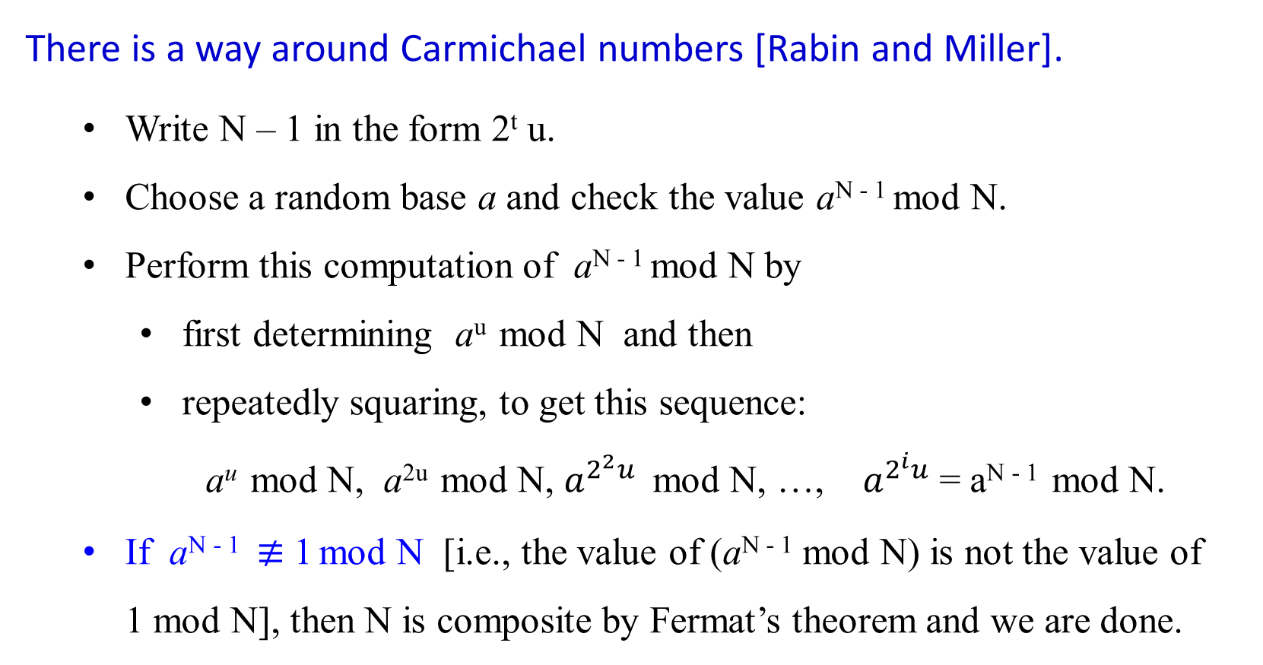
There is a way around Carmichael numbers [Rabin and Miller].
Write N – 1 in the form 2^{t} u.
Choose a random base a and check the value a^{N - 1} mod N.
Perform this computation of a^{N - 1} mod N by
first determining a^{u} mod N and then
repeatedly squaring, to get this sequence:
a^{u} mod N, a^{2u} mod N, $a^{2^{2}u}$ mod N, …, $a^{2^{i}u}$ = a^{N - 1} mod N.
If a^{N - 1} $≢$ 1 mod N [i.e., the value of (a^{N - 1} mod N) is not the value of 1 mod N], then N is composite by Fermat’s theorem and we are done.

Slide 21
There is a way around Carmichael numbers [Rabin and Miller] - continued
If a^{N-1} ≡ 1 (mod N), we conduct a follow-up test:
somewhere in the preceding sequence, we ran into a 1 for the first time.
If this happened after the first position (that is, if a^{u} mod N ≠ 1), and if the preceding value in the list is not -1 mod N, then we declare N composite.
In the latter case, a nontrivial square root of 1 modulo N is found:
a number that is not ±1 mod N but that when squared is equal to 1 mod N. Such a number can only exist if N is composite.
If we combine this square-root check with earlier Fermat test, then at least three-fourths of the possible values of a between 1 and N – 1 will reveal a composite N, even if it is a Carmichael number.

Slide 22
The Miller-Rabin algorithm for primality testing of integers is
an impressive randomized algorithm (e.g., Cormen: p 968-975).
This randomized algorithm solves the problem
in an acceptable amount of time for thousand-digit numbers
with the probability of yielding an erroneous answer smaller than the probability of hardware malfunction.
It is faster than the best known deterministic algorithms for solving this problem, which is crucial for modern cryptology.
+++++++++++++++++++++++++++++++++++++++++++++++++++++++++++++++++end

Slide 23
In a Carmichael-free universe, the algorithm works well.
Any prime number N will pass Fermat’s test and produce the right answer.
Any non-Carmichael composite number N must fail Fermat’s test for some value of a; and
this implies immediately that N fails Fermat’s test for at least half the possible values of a!

Slide 24
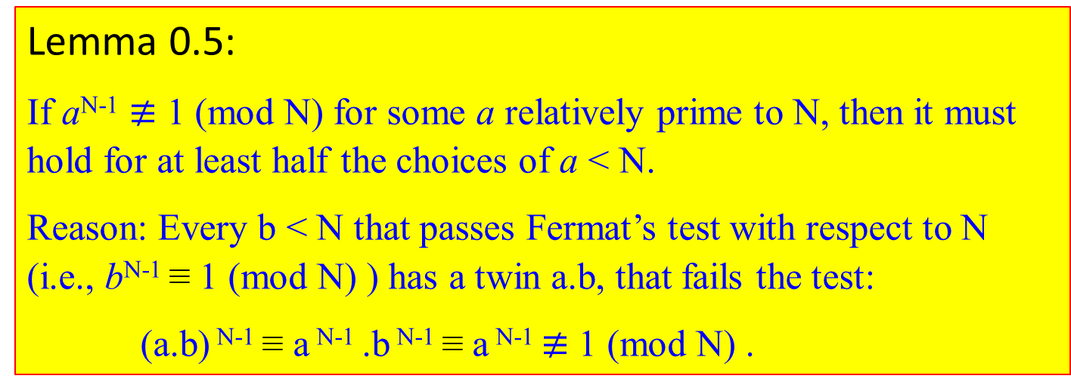
Theorem 0.3:
There are infinitely many primes.
Reason: Assume that there are only n primes, p₁, p₂, …, p_{n} . Let Q = p₁ p₂ … p_{n} + 1. If p_{k} divides Q, then p_{k} divides Q - p₁ p₂ … p_{n} = 1. This implies that Q is either a prime or a prime factor of Q.
Lemma 0.5:
If a^{N-1} $≢$ 1 (mod N) for some a relatively prime to N, then it must hold for at least half the choices of a < N.
Reason: Every b < N that passes Fermat’s test with respect to N (i.e., b^{N-1} ≡ 1 (mod N) ) has a twin a.b, that fails the test:
(a.b) ^{N-1} ≡ a ^{N-1} .b ^{N-1} ≡ a ^{N-1} $≢$ 1 (mod N) .

Slide 25

Disregarding the Carmichael numbers, let assert
if N is prime, then a^{N-1} ≡ 1 (mod N), for all a < N.
if N is not prime then a^{N-1} ≡ 1 (mod N), for at most half the values of a < N.
The algorithm of Figure 1.7, therefore, has the following probabilistic behavior.
Pr(Algorithm 1.7 returns yes when N is prime) = 1
Pr(Algorithm 1.7 returns yes when N is not prime) ≤ $\frac{1}{2}$ .
Reduce this one-sided error by repeating the procedure many times, by randomly picking several values of a and testing them all (Figure 1.8).
Pr(Algorithm 1.8 returns yes when N is not prime) ≤ $\frac{1}{{ 2}^{k }}$ .

Slide 26
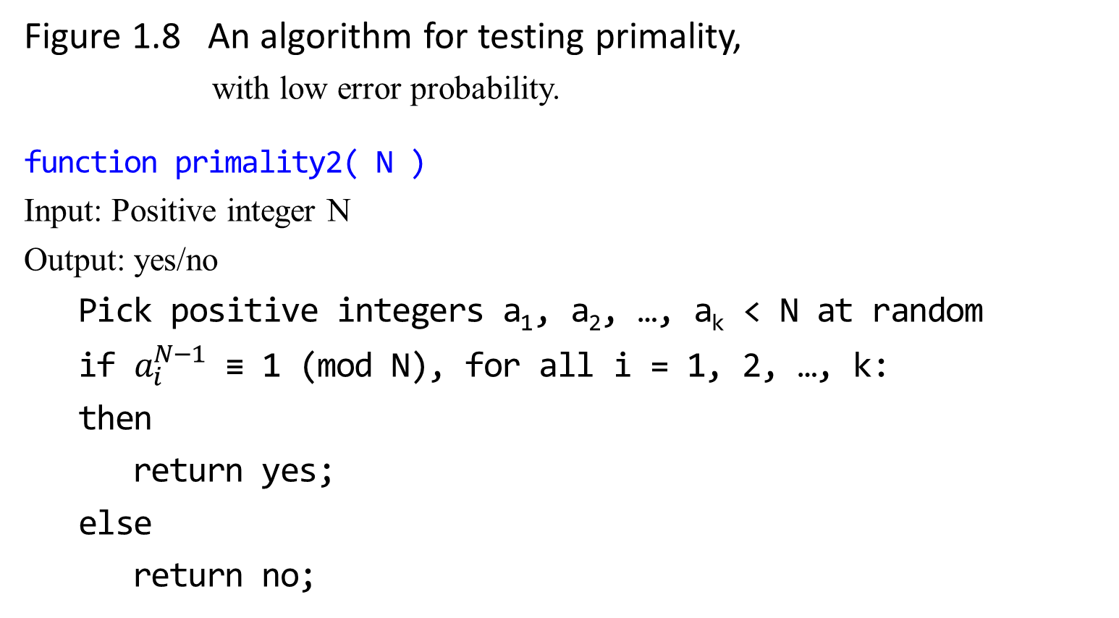
Figure 1.8 An algorithm for testing primality, with low error probability.
function primality2( N )
Input: Positive integer N
Output: yes/no
Pick positive integers a₁, a₂, …, a_{k} < N at random
if $a_{i}^{N−1}$ ≡ 1 (mod N), for all i = 1, 2, …, k:
then
return yes;
else
return no;

Slide 27

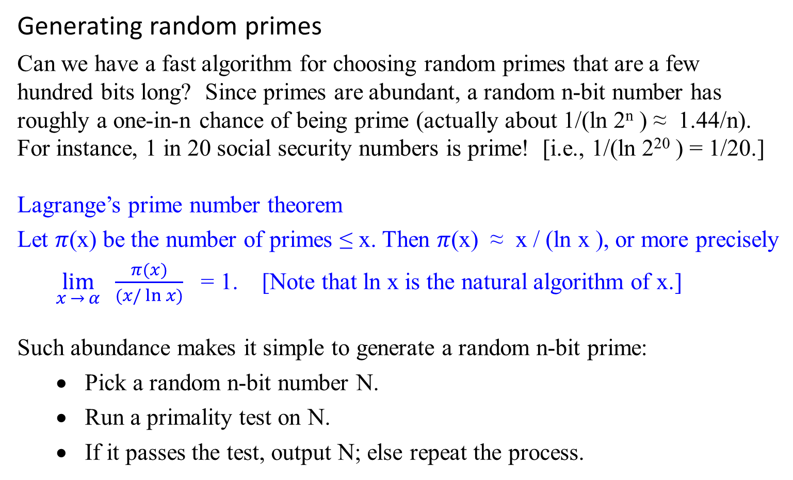
Generating random primes
Can we have a fast algorithm for choosing random primes that are a few hundred bits long? Since primes are abundant, a random n-bit number has roughly a one-in-n chance of being prime (actually about 1/(ln 2^{n} ) ≈ 1.44/n). For instance, 1 in 20 social security numbers is prime! [i.e., 1/(ln 2²⁰ ) = 1/20.]
Lagrange’s prime number theorem
Let $π$(x) be the number of primes ≤ x. Then $π$(x) ≈ x / (ln x ), or more precisely
$\lim_{x → α}{\frac{π(x)}{(x/\ln{x)}}}$ = 1. [Note that ln x is the natural algorithm of x.]
Such abundance makes it simple to generate a random n-bit prime:
Pick a random n-bit number N.
Run a primality test on N.
If it passes the test, output N; else repeat the process.

Slide 28
How fast is this algorithm?
If the randomly chosen N is truly prime, with a probability of at least 1/n, then it will certainly pass the test.
On each iteration, this procedure has at least a 1/n chance of halting. Therefore, on average it will halt within O(n) rounds.
Which primality test should be used?
It is sufficient to perform the Fermat test with base a = 2 (or to be really safe, a = 2, 3, 5) because for random numbers the Fermat test has a much smaller failure probability than the worst-case ½ bound.

Slide 29
What is the probability that the output of the algorithm is really prime?
Suppose the test is performed with base a = 2 for all numbers N ≤ 25 * 10⁹.
In this range, there are about 10⁹ primes, and about 20,000 composites that pass the test.
Thus, the chance of erroneously outputting a composite is approximately 20,000/10⁹ = 2 * 10⁻⁵.
This chance of error decreases rapidly as the length of the numbers involved is increased to a few hundred digits we expect in applications.

Slide 30

Composites
Primes
Fail
Fermat test
(base a = 2)
≈ 20,000 composite
≈ 10⁹ primes
Pass
Before primality test:
All numbers N ≤ 25 * 10⁹ after primality test

Slide 31

Finding Large Prime Numbers
find large prime numbers, which is necessary to the success of the RSA public-key cryptosystem.
then show an algorithm for testing whether a number is prime.

Slide 32
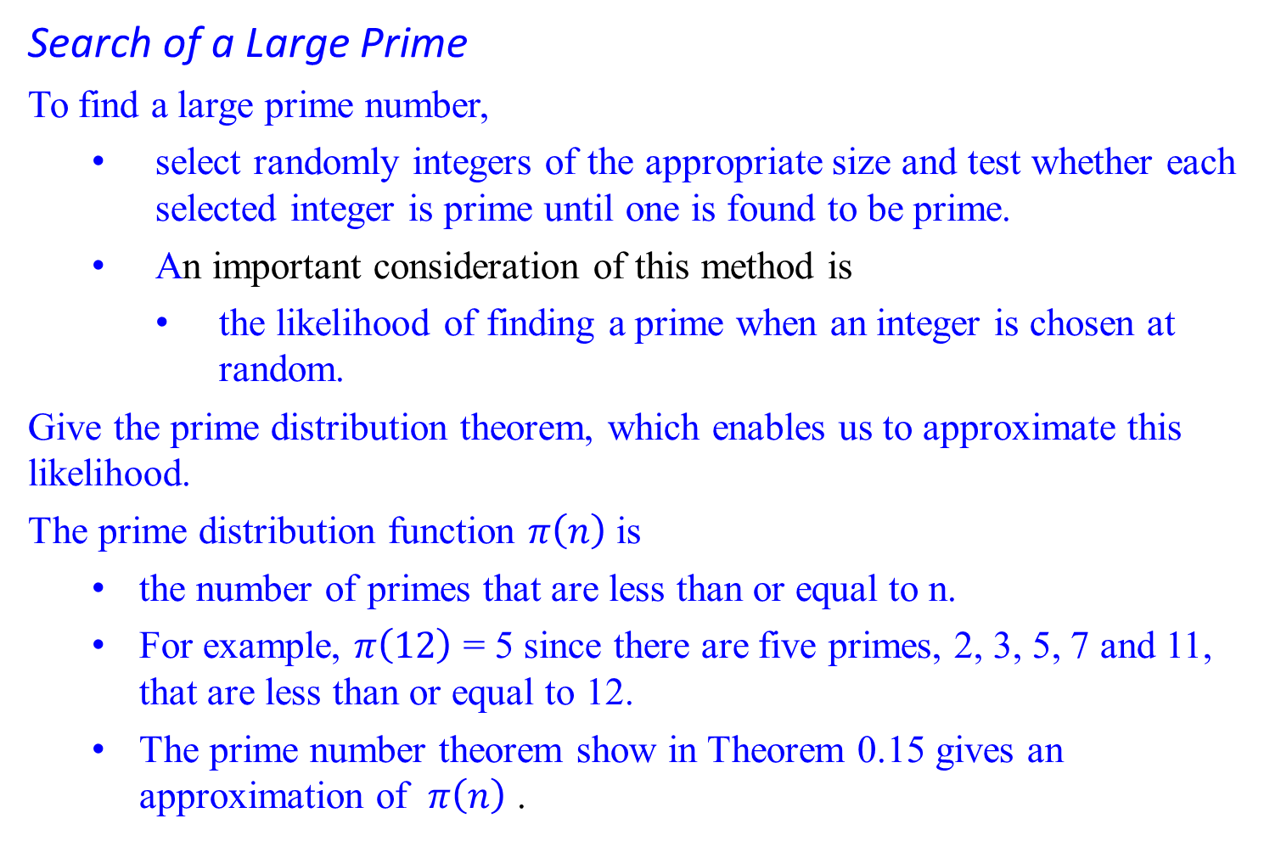
Search of a Large Prime
To find a large prime number,
select randomly integers of the appropriate size and test whether each selected integer is prime until one is found to be prime.
An important consideration of this method is
the likelihood of finding a prime when an integer is chosen at random.
Give the prime distribution theorem, which enables us to approximate this likelihood.
The prime distribution function $π\left(n\right)$ is
the number of primes that are less than or equal to n.
For example, $π\left(12\right)$ = 5 since there are five primes, 2, 3, 5, 7 and 11, that are less than or equal to 12.
The prime number theorem show in Theorem 0.15 gives an approximation of $π\left(n\right)$ .

Slide 33
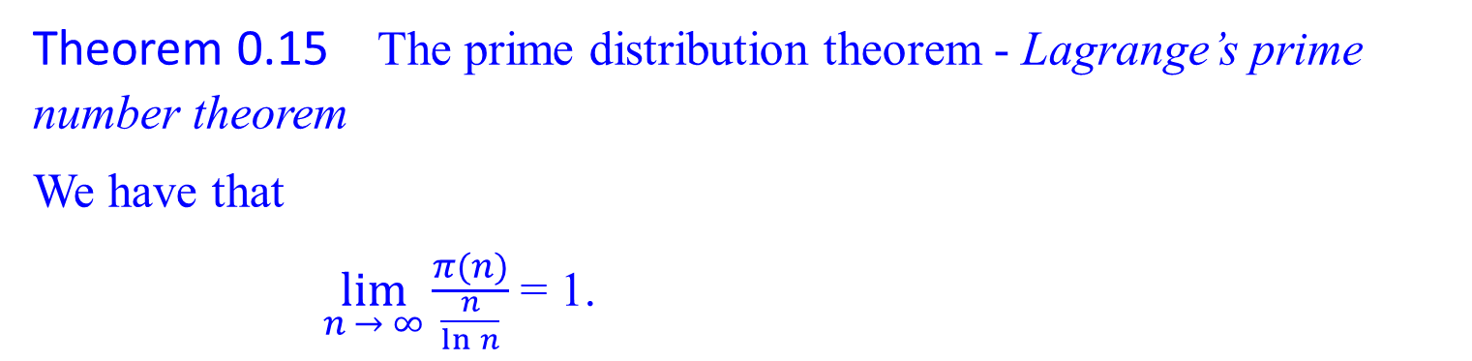
Search of a Large Prime
Theorem 0.15 The prime distribution theorem - Lagrange’s prime number theorem
We have that
$\lim_{n → ∞}{\frac{π(n)}{\frac{n}{\ln{n}}}}$ = 1.

Slide 34
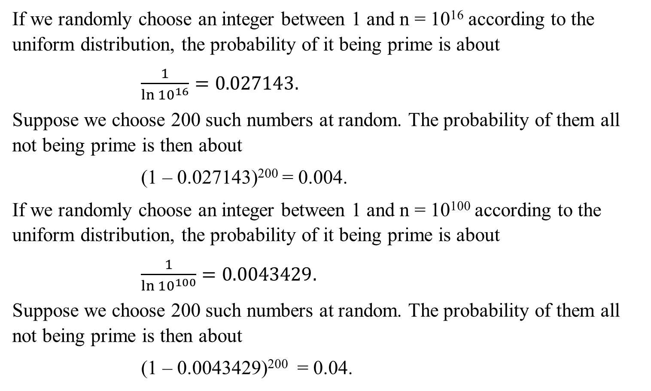
If we randomly choose an integer between 1 and n = 10¹⁶ according to the uniform distribution, the probability of it being prime is about
$\frac{1}{\ln{{10}^{16}}}=0.027143.$
Suppose we choose 200 such numbers at random. The probability of them all not being prime is then about
(1 – 0.027143)²⁰⁰ = 0.004.
If we randomly choose an integer between 1 and n = 10¹⁰⁰ according to the uniform distribution, the probability of it being prime is about
$\frac{1}{\ln{{10}^{100}}}=0.0043429.$
Suppose we choose 200 such numbers at random. The probability of them all not being prime is then about
(1 – 0.0043429)²⁰⁰ = 0.04.

Slide 35

Cryptography – The RSA Public Key Cryptosystem
The Rivest-Shamir-Adleman (RSA) cryptosystem uses all the ideas we have introduced in this lecture note. It derives very strong guarantees of security by ingeniously exploiting the wide gulf between the polynomial-time computability of certain number-theoretic tasks: (
modular exponentiation,
greatest common divisor,
primality testing) and
the intractability of others (factoring).
113

